Slide 1

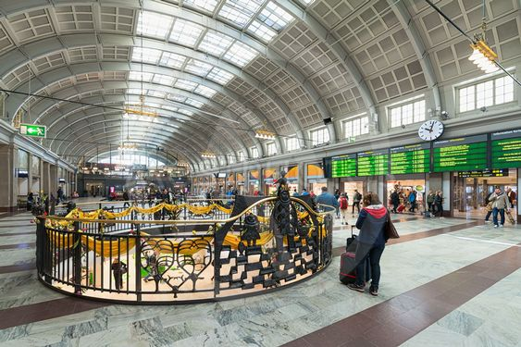
Trip to Uppsala
Saturday 16 November 2024
09:11 – 09:49 Train ride to Uppsala
10:15 – 11:30 Guided tour of the Carl Linnaeus museum and garden
11:30 – 13:00 Lunch and time for walking around the city centre
(on your own)
13:00 – 14:00 Guided tour of the cathedral
14:00 – 15:00 Guided tour of the Gustavianum museum
15:00 – 16:40 Rune stones, Carolina Rediviva library
and the Codex Argenteus (silver bible)
Walk around Uppsala (on you own)
16:44 – 17:23 Train ride to Stockholm
18:00 – 22:00 Reception at the Stockholm University,
in lunch room on floor E5
Meeting point
Main hall of the Central station
08:45, next to the floor opening
More information
Carl Linnaeus museum: http://www.linnaeus.se/en
Gustavianum museum: https://uppsalasmuseer.se/museum/gustavianum/
Cathedral: https://en.wikipedia.org/wiki/Uppsala_Cathedral
Codex Argenteus https://en.wikipedia.org/wiki/Codex_Argenteus
Runstones: https://en.wikipedia.org/wiki/Runestone
Train costs, museum tickets and party at SU are paid by the course. The lunch in Uppsala is on your own. Bring sandwiches if you do not want to eat in a bar!
Please bring an identity card with you. It is needed for the trian ticket.

Slide 2
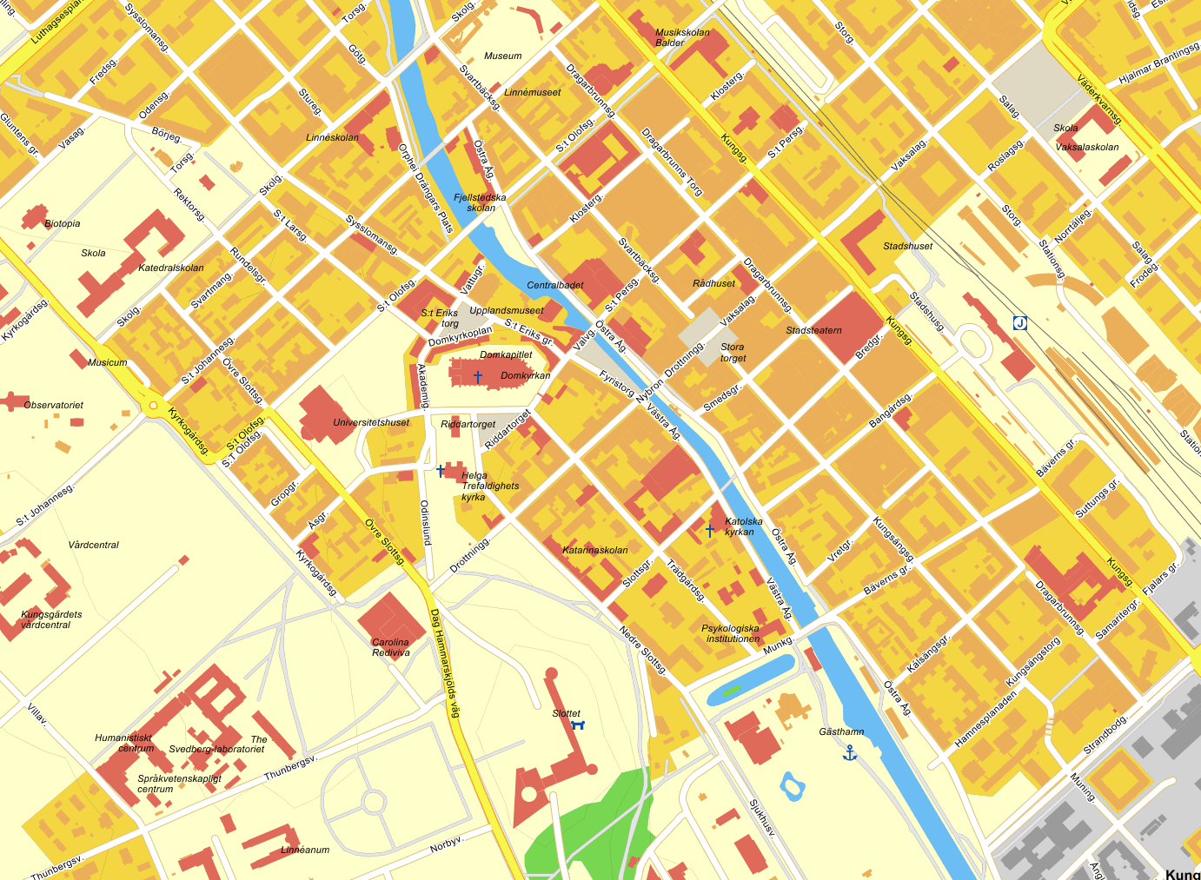
Plan of central Uppsala
University building
and runstones
Gustavianum museum
Linnaeus museum
Train station
Karolina
Rediviva
Castle
Cathedral

